Slide 1


CONVOLUTION NEURAL NETWORK
Deep Learning
Presented By : Apsara B.K,Sristi Ghimire
Reviewed By : Sampada kharel,Subina Maharjhan, Rupesh Budhathoki,Sandip Nepali

Slide 2
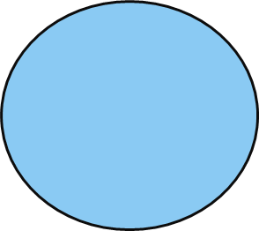
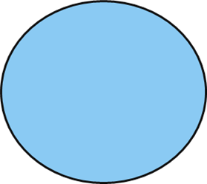


Table of contents
1
2
3
Introduction
of CNN
APPLICATION OF CNN?
Architecture of CNN

Slide 3

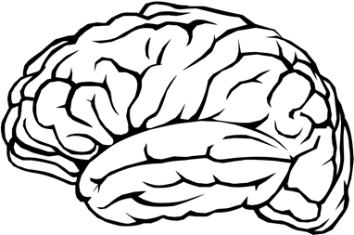
ABOUT
CONVOLUTION NEURAL NETWORK
3

Slide 4


Convolution Neural Network(CNN)
Convolution neural networks (CNNs) are type of artificial neural network used in deep learning.
They are inspired by the structure of the brain and
are used to recognize patterns in data.
CNNs are trained using large dataset of images and videos, and can learn to recognize and understand the visual environment in a way that is similar to how human would

Slide 5
Applications of CNN
Facial Emotion
Recognition
Face
Detection
Analyzing
documents
Medical
Imaging
Self-driving
Cars

Slide 6

Image Recognition

Slide 7
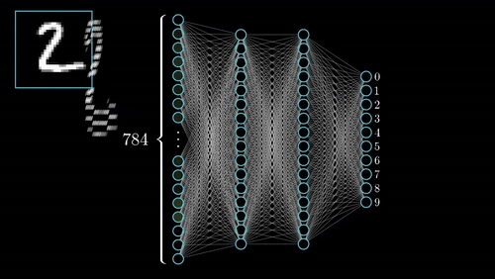
MNIST handwritten digit classification

Slide 8
3
Architecture of Convolution neural network
8

Slide 9
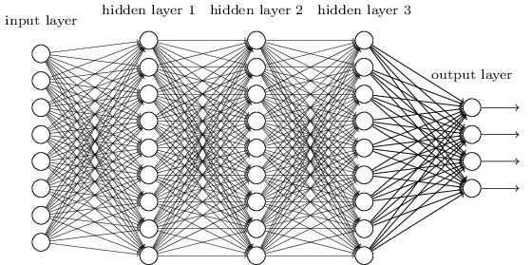
Working of CNN
CNNs are composed of several layers of neurons that are organized in a hierarchical structure.
Each layer is composed of a set of neurons that are connected to each other.
The neurons in each layer process the input data and pass the output to the next layer.

Slide 10
Architecture of Convolution neural network
The architecture of a CNN typically consists of several layers, including:
Convolutional layers: These layers apply a convolution operation to the input data, which helps to identify and extract features from the image.
Pooling layers: These layers are used to reduce the spatial dimensions of the convolutional layers, which helps to reduce the computational complexity of the network.
Fully connected layers: These layers are used to make predictions based on the features extracted by the convolutional and pooling layers.
Soft max layer: This is used to output probability distribution of the output.
13
Notes:
These layers are stacked on top of each other to form a deep neural network, which allows the model to learn increasingly complex features from the input data.

Slide 11
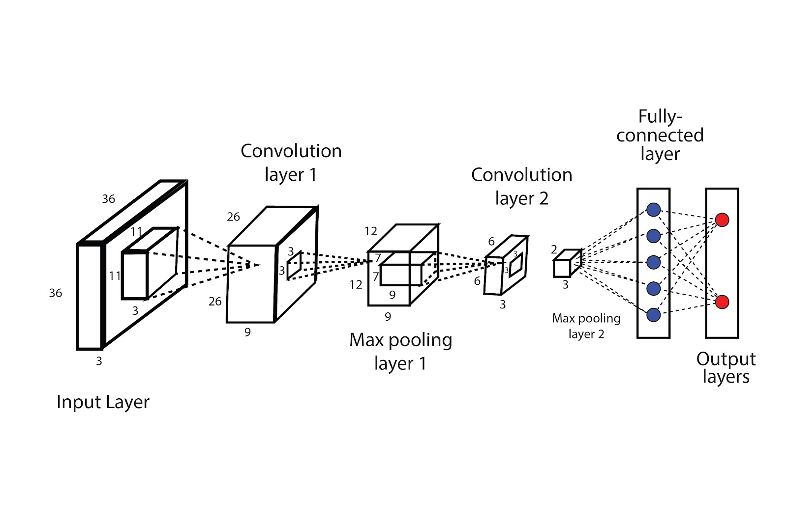
The architecture of Convolutional Neural Networks(CNN)
15

Slide 12



The Whole CNN
CAT
Convolution
Max Pooling
Fully Connected Feedforward network
Convolution
Max Pooling
Flattened

Slide 13

SUMMARY
A convolutional neural network (CNN) is a type of artificial neural network that uses convolutional layers to automatically and adaptively learn spatial hierarchies of features from input data such as images, videos and audio. It is designed to process data through multiple layers, each of which applies a series of filters to the input to extract key features, allowing the network to learn increasingly complex representations of the data.

Slide 14
References:
https://en.wikipedia.org/wiki/Convolutional_neural_network
https://www.analyticssteps.com/blogs/convolutional-neural-network-cnn-graphical-visualization-code-explanation
https://towardsdatascience.com/a-comprehensive-guide-to-convolutional-neural-networks-the-eli5-way-3bd2b1164a53

Slide 15
THANK YOU!!!

